Slide 2
What’s New & Cool in NetBeans IDE 7.x (Highlights of NetBeans IDE 7.0, 7.1, 7.2, 7.3, and 7.4)
Notes:
In this presentation, you’ll be focusing on new features in NetBeans IDE, while also providing a context for those of your audience who are not familiar with NetBeans IDE.

Slide 3
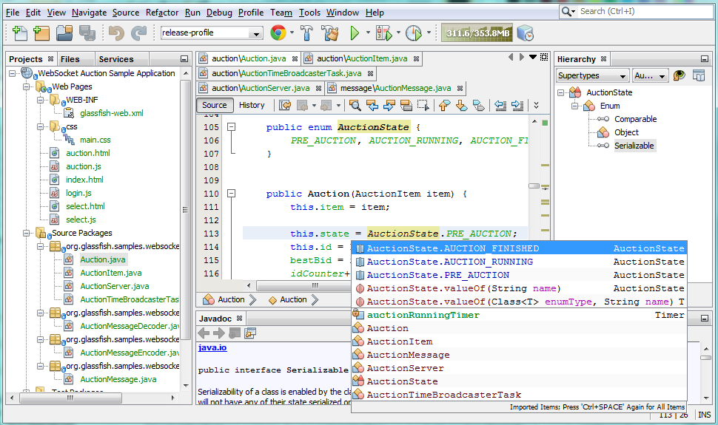
What is NetBeans IDE?
A Comprehensive & Modular Development Environment
Ready to use out of the box
Support for latest Java specifications & standards
Other platforms too (HTML5, PHP, C/C++)
Intuitive workflow
Debugger, Profiler, Refactoring, etc.
Binaries and ZIPs for Mac OS, Linux, and Windows
Simply download and run on any operating system!
Notes:
Here you’re giving a high level overview of NetBeans IDE. It’s two key features are that
It has everything needed for getting started with Java development, out of the box. (Unlike Eclipse.)
It is completely free. (Unlike IntelliJ IDEA.)
Talk on each of the bullets, just sharing your own knowledge on these points.
The main focus of this presentation is the new HTML5 support, though point out that Java development continues to be the main focus of the IDE.
Many developers don’t know that NetBeans is not only available via installers, but also as a ZIP file.

Slide 4
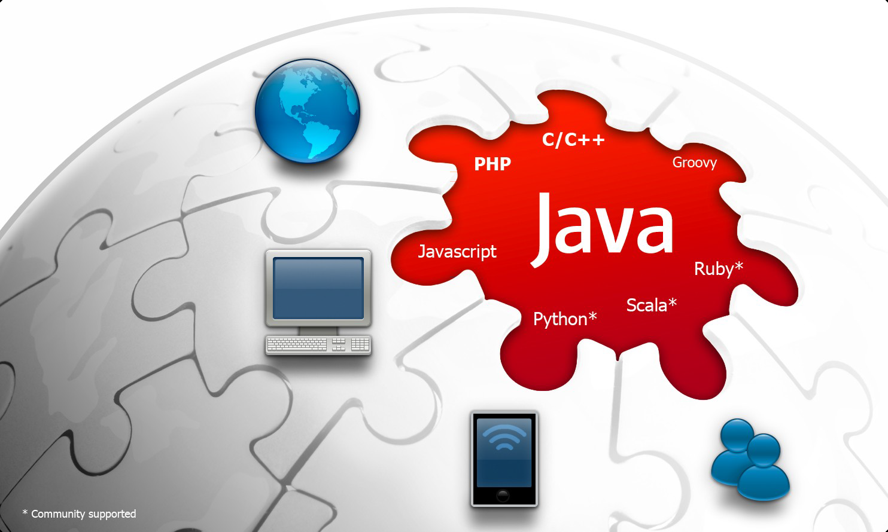
What is NetBeans IDE?
A Comprehensive & Modular Development Environment
NEW! HTML5 Support
Notes:
Java, PHP, and C/C++ are the main language platforms supported by the IDE, now with the addition of HTML5.
Groovy is also supported and some attention has been given to it in the past few releases,
See blogs.oracle.com/netbeansgroovy
But the IDE is pluggable and provides many editor APIs, making it possible for Python, Scala, Ruby, and other languages to be supported.

Slide 5
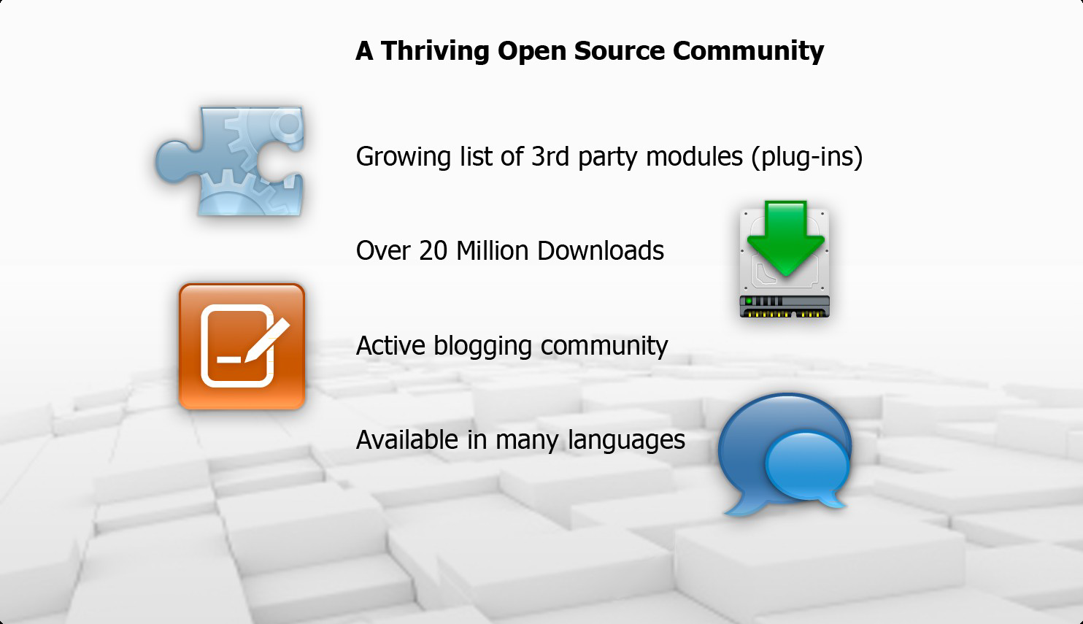
What is NetBeans IDE?
A Comprehensive & Modular Development Environment
Notes:
NetBeans is an IDE, an application framework, and a large international community.
In 2011, NetBeans attained the 1,000,000 active user status, and it continues to grow.

Slide 6

Why Use NetBeans IDE?
Increase Developer Productivity
Works out of the box
Freely available
Open source
Support for Java standards & other popular platforms, such as HTML5
Deeply integrated Maven support
Extensible Java desktop framework
Powerful, award winning GUI Builder
Profiling and debugging tools
Customizable and extensible
Notes:
Again, mention the “out of the box” and “free” aspects a lot.
Java EE and Maven – there’s no better IDE for these technologies than NetBeans IDE.
There’s also a large community working on creating plugins (i.e., the ‘customizable and extensible’ item above).

Slide 7
What’s New in NetBeans IDE 7.x
Overview of New Features and Enhanced Support
Java Language
Java EE Platform
JavaFX Platform
HTML5 Platform
PHP and C/C++ Languages
Miscellaneous IDE Tools

Slide 8
Java Language
Notes:
In this presentation, you’ll be focusing on new features in NetBeans IDE, while also providing a context for those of your audience who are not familiar with NetBeans IDE.

Slide 9
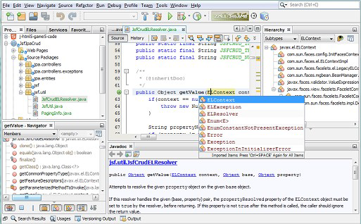
Support for the Java Language
Out of the Box Java Language Support
Java Editor is NetBeans IDE’s central feature
Developed in close co-operation with Oracle Java SE Team
First editor to support Java technologies, e.g., JDK, Java EE, JavaFX
“javac” is our parser, all language features are always in sync with Java

Slide 10

Support for the Java Language
Feature Overview
At Liquid Robotics, our use of NetBeans IDE is all about integration. There's the seamless integration of development tools and Java technologies within NetBeans IDE, but it's also very good at integrating external features, for example, Jenkins, which we use for our build server, Git (via GitBlit), which is our source code repository, JIRA for bug tracking, Maven for running builds, and Artifactory for maintaining the artifacts created from the builds.
Much More Than Creating, Editing, Refactoring
Building
Maven and Ant, community Gradle plugin
Debugger and Profiler
Versioning
Git, Mercurial, and Subversion
Testing and Code Analysis
Junit and TestNG
Static code analysis, e.g., FindBugs
Continuous Build Servers
Bug Tracking
JIRA, Bugzilla
“Father of Java”
James Gosling
CTO, Liquid Robotics

Slide 11
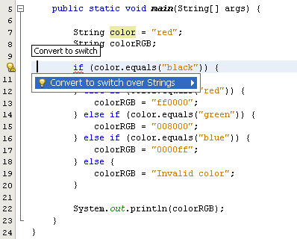
JDK 7 Support
NEW 7.0
Support for the Java Language
Editor enhancements
Intuitive new Java refactoring hints
Strings in switch
Diamond support
Support for try-with-resources
Multicatch support
New integer literal support
Batch refactor multiple projects to JDK 7 simultaneously

Slide 12
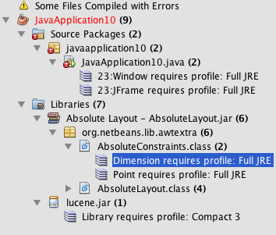
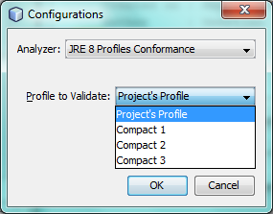
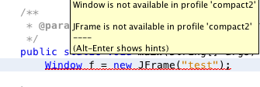
JDK 8 Preview Support
NEW 7.4
Support for the Java Language
Out of the box JDK 8 Profiles Support
Syntax and code completion support for Lamba expressions
Refactoring tools for changing anonymous inner classes to Lambda expressions
Lambda expressions are handled by debugger

Slide 13
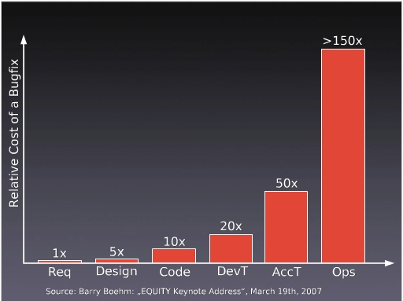
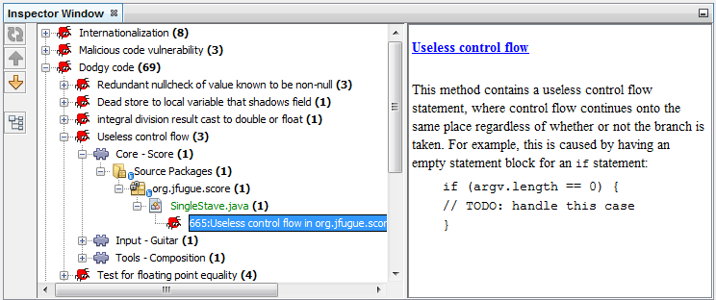
Smart Static Analysis via FindBugs
NEW 7.2
Support for the Java Language
Earlier bugs are found, lower cost in fixing them
FindBugs
Programming Style
Programming Techniques
“Dodgy code”, e.g., useless control flow
Set scope of analysis on projects, packages, or files
Examine results and jump into editor

Slide 14
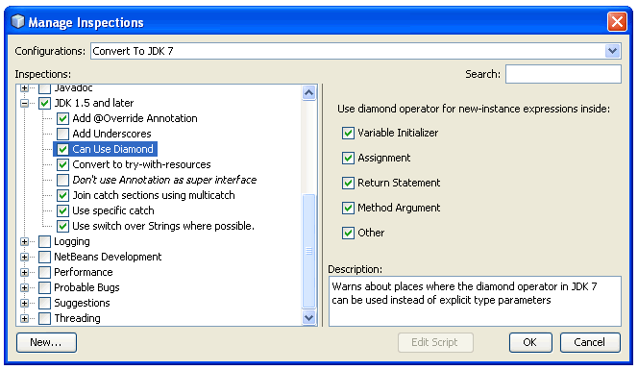
Smart Refactoring
NEW 7.2
Support for the Java Language
Quickly fix problems across packages & projects
Upgrade projects completely to JDK 7 or JDK 8 (preview)
Define finetuned customized scopes
Expression language for defining rules

Slide 15
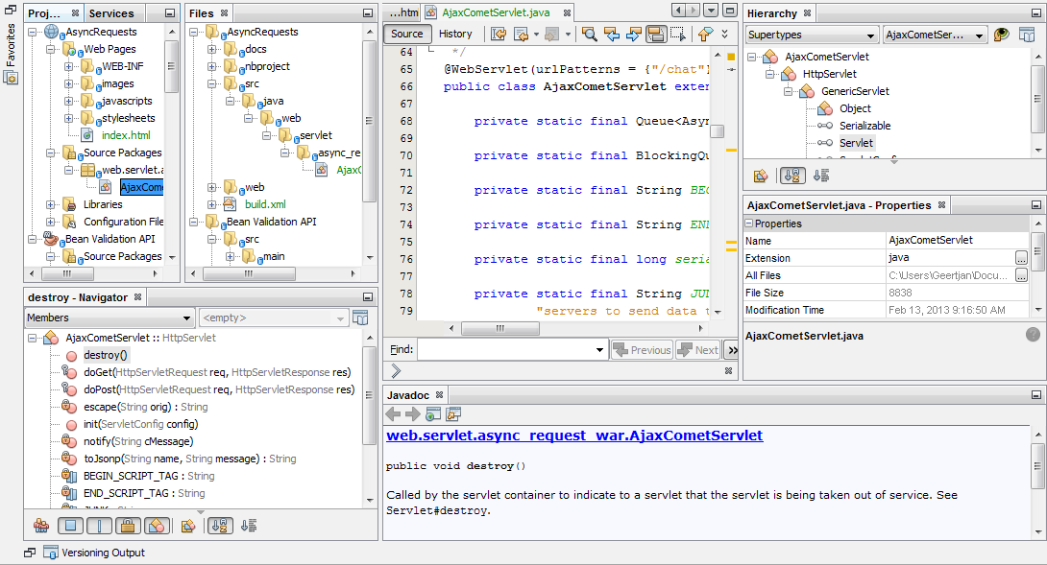
Smart Code Navigation
NEW 7.3
Support for the Java Language
Rewritten Hierarchy window for supertypes and subtypes
New Breadcrumb Toolbar beneath editor
New Brace Matching Bar above editor

Slide 16
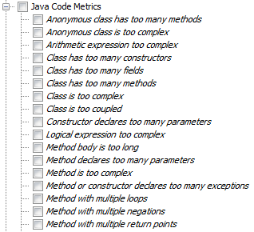
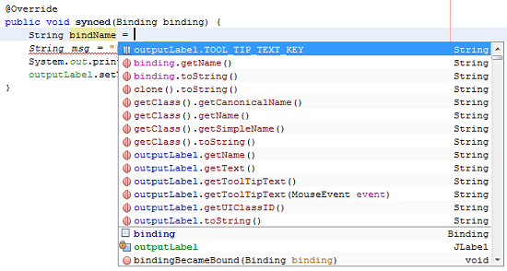
Smart Editing Tools
NEW 7.4
Support for the Java Language
Java Code Metrics
Distraction-free mode
Remove surrounding code
New hints, refactorings, and code completions
Block selection

Slide 17
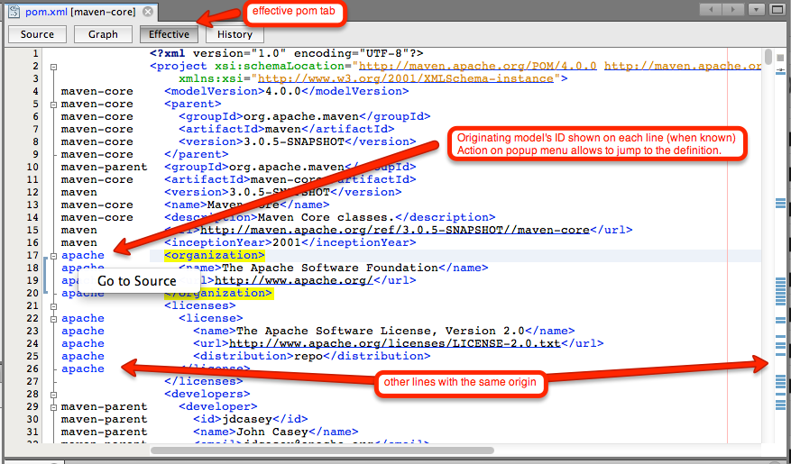
Smart Maven Build Tools
NEW
Support for the Java Language
Key feature: POM is NetBeans project, no NetBeans files added
Less memory needed for Maven projects
Effective POM tab shows origin of elements
Code Generator for POM files to generate license headers

Slide 18
Java EE Platform
Notes:
In this presentation, you’ll be focusing on new features in NetBeans IDE, while also providing a context for those of your audience who are not familiar with NetBeans IDE.

Slide 19
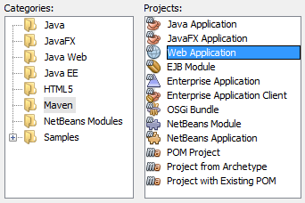
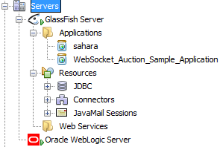
Support for Java EE
Out of the Box Java EE Support
Developed in close co-operation with GlassFish and WebLogic teams
Best in breed GlassFish integration, strong support for WebLogic and other servers
First day support for standards, e.g., Java EE 6 and Java EE 7
No plugins needed Ready to use out of the box

Slide 20

Support for Java EE
Feature Overview
We have found that NetBeans IDE is fast at introducing new features that ease Java EE development and integrates perfectly with popular tools like Maven.
In fact, we consider NetBeans IDE to provide the best Maven integration of any IDE we have encountered.
Much More Than Creating, Editing, Refactoring
Frameworks
bundled PrimeFaces
support for RichFaces and IceFaces
Building
Maven, Ant, and Gradle plugin
Debugging and Profiling
Versioning
Git, Mercurial, and Subversion
Testing and Code Analysis
Junit and TestNG
Static code analysis (e.g., FindBugs)
Çağatay Çivici PrimeFaces Lead

Slide 21
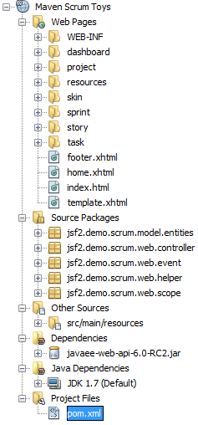
Support for Maven
Feature Overview
Maven defines the POM: the POM is the project, no NetBeans files needed at all
All execution happens through Maven, thus the IDE executes tests exactly how CI does it, for example
Since NetBeans IDE 7.4, “compile on save” is supported, in addition, ZeroTurnaround has created NetBeans JRebel plugin
All of this is available “out of the box”, without installing any plugins of any kind

Slide 22
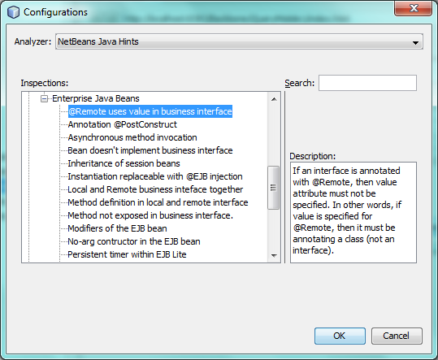
Java EE 7 Development Tools
NEW 7.3.1
Support for Java EE
Support for latest specifications (JAX-RS 2.0, JMS 2.0, JSF 2.2, CDI 1.1, EJB 3.2, EL 3.0, WebSocket 1.0, JSP 2.1, and more)
Support for latest JSF features
Pass-through attributes & elements
Resource library contracts
Page Flow support
Annotation-based component registration
@FlowScoped scope
JSF templates & tools for client creation
Facelets templates & client creation
Many new hints

Slide 23
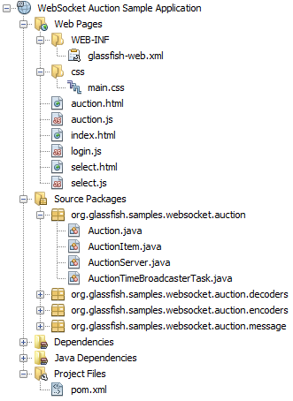
HTML5 Development Tools
NEW 7.4
Support for Java EE
Easy to use HTML5 features in Java EE applications
Features:
JavaScript Library Manager
JavaScript Editor and Debugger
CSS preprocessors
Visual CSS Editor
Integration between IDE and Chrome browser
Deployment to mobile devices
Project samples
(More details later in these slides.)

Slide 24
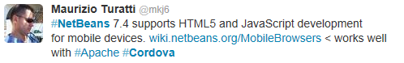



Community Feedback
The Smarter and Faster Way to Code

Slide 25
JavaFX Platform
Notes:
In this presentation, you’ll be focusing on new features in NetBeans IDE, while also providing a context for those of your audience who are not familiar with NetBeans IDE.

Slide 26
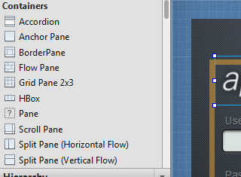
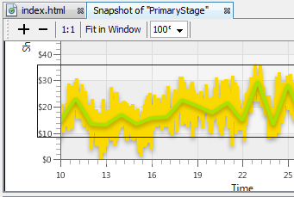
Support for JavaFX
NEW 7.1
Out of the Box JavaFX Support
First IDE to provide JavaFX tools
Developed in close co-operation with the JavaFX team
Supports full create/compile/debug cycle
Integrated with Scene Builder
Library of ready to use samples out of the box

Slide 27
HTML5 Platform
Notes:
In this presentation, you’ll be focusing on new features in NetBeans IDE, while also providing a context for those of your audience who are not familiar with NetBeans IDE.

Slide 28
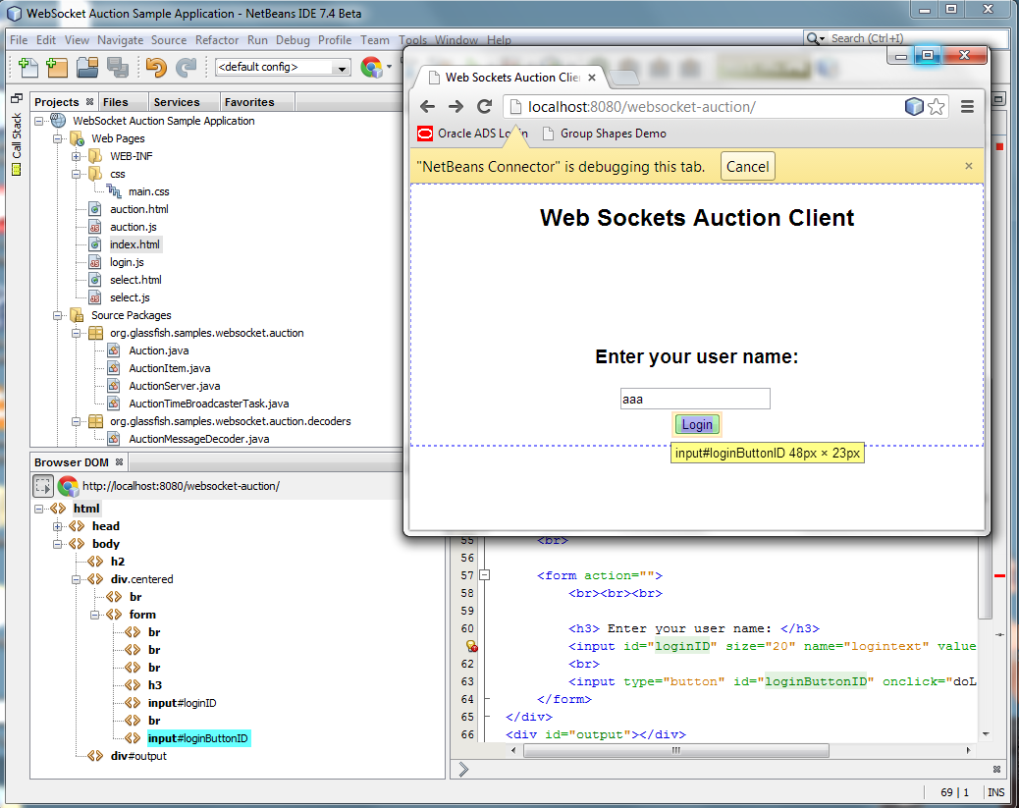
Support for HTML5
NEW 7.3
Out of the Box HTML5 Support
Features for HTML5, JavaScript, and CSS3 in HTML projects, Java EE (Maven and Ant) projects, and in PHP projects
Integration between NetBeans IDE and Chrome browser
Editors for HTML5, JavaScript, CSS3
JavaScript debugger
Visual CSS editing
SASS and LESS CSS preprocessing
Cordova mobile device development

Slide 29
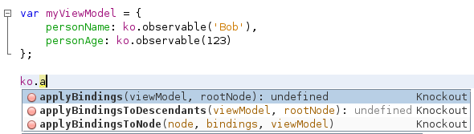
Cutting Edge JavaScript Editor
NEW 7.3 7.4
Support for HTML5
Early JDK 8 build Nashorn JavaScript Engine for parsing
Out of the box support:
jQuery
JSON
Knockout
Ext Js
AngularJS
JsDoc
ExtDoc
ScriptDoc

Slide 30
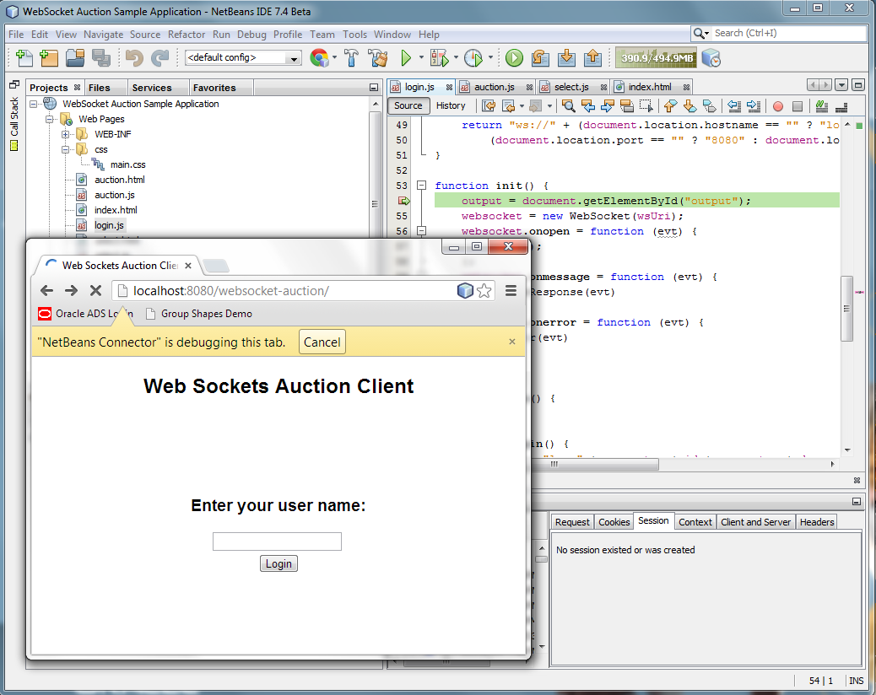
Quick JavaScript Debugger
NEW 7.3
Support for HTML5
HTML5 applications are automatically deployed in debug mode
Set breakpoints in JavaScript file, on Line, DOM, Event, or XMLHTTPRequest
Refresh the browser and immediately step through code
Use Debugger windows to monitor watches, threads, and breakpoints

Slide 31
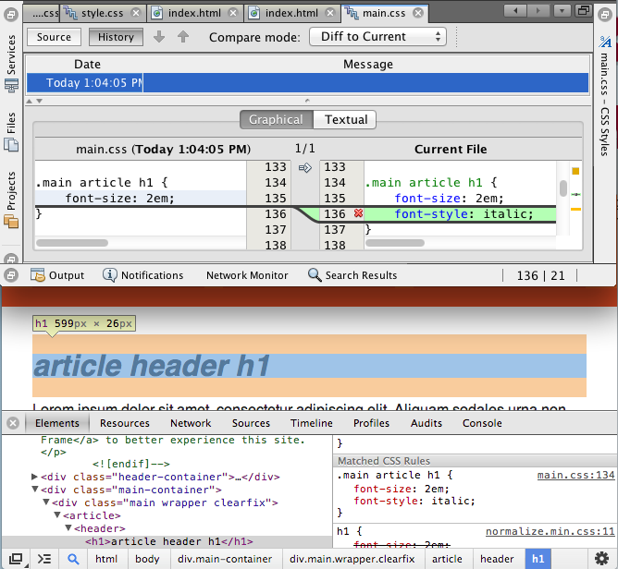
Visual CSS Editing
NEW 7.3
Support for HTML5
Click in browser and see CSS styles and rules in IDE
Changes saved in Chrome Developer Tools are saved in files in IDE
CSS styling: box model styling of hover-based effects
Changes in CSS Editor immediately reflected in browser

Slide 32
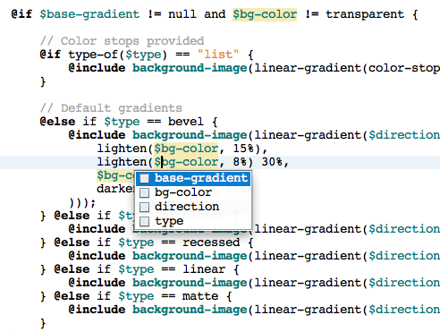
SASS and LESS Preprocessing
NEW
7.4
Support for HTML5
Syntax coloring, indentation, reformatting, code folding, file templates
Go to declaration, mark occurrences, instant rename, code completion
Live reload on change
Debugging information is displayed

Slide 33
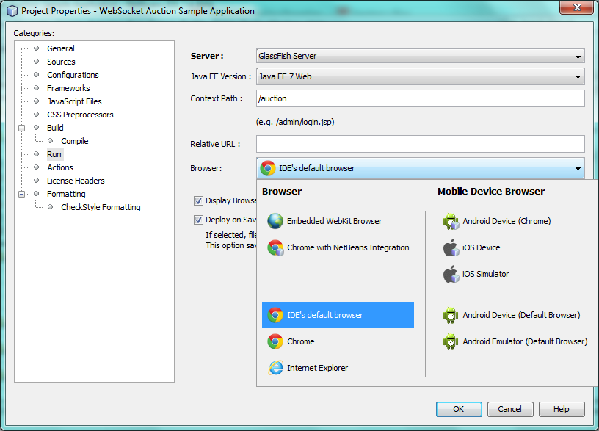
Easy Mobile & Web Deployment
NEW 7.4
Support for HTML5
Tight integration with
Chrome
Embedded WebKit Browser
iOS (Safari)
Android (Chrome)
Also support for Internet Explorer, FireFox, Safari, Android default browser

Slide 34
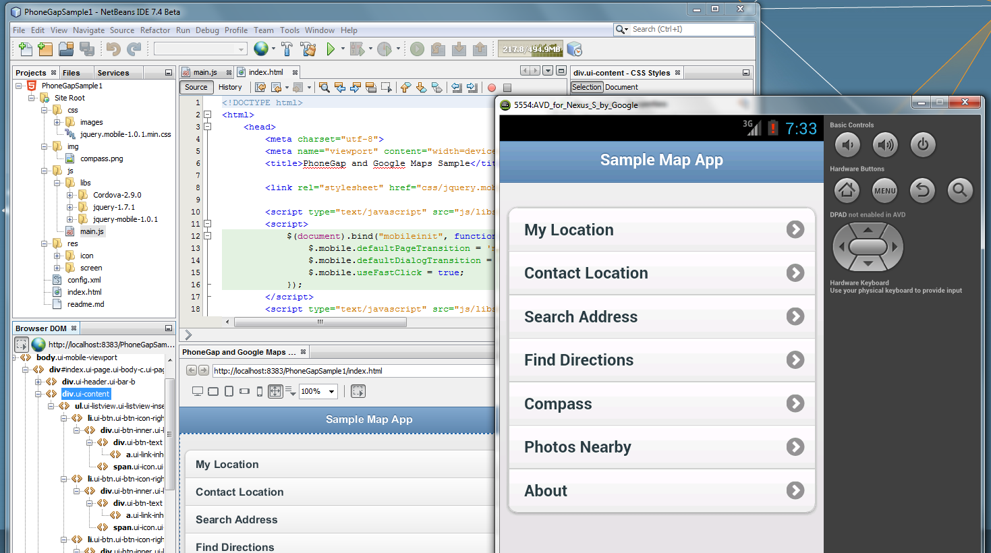
Cordova Mobile Device Support
NEW 7.4
Support for HTML5
Cordova integration for hybrid development
Build native Android and iOS packages
Register or generate required files for Android and iOS
Register Android SDK and iOS SDK
Helpful samples and templates

Slide 35





Community Feedback
The Smarter and Faster Way to Code

Slide 36
PHP and C/C++
Notes:
In this presentation, you’ll be focusing on new features in NetBeans IDE, while also providing a context for those of your audience who are not familiar with NetBeans IDE.

Slide 37
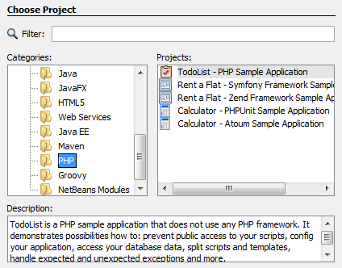
Support for PHP
Feature Overview
Templates & samples for PHP projects and files
Editor support (code completion, navigation, refactoring, hints, coloring, etc.)
Integration with HTML, JavaScript, CSS
Debugger (Xdebug)
Unit testing (PHPUnit, atoum)
PHP frameworks (Symfony 1 &2, Zend 1 and 2, Nette, Doctrine, Smarty)
Dependency management (Composer)
API documentation support (ApiGen, PhpDocumentor)
Static code analysis (Code Sniffer, Mess Detector)
Continuous integration (Hudson/Jenkins)

Slide 38
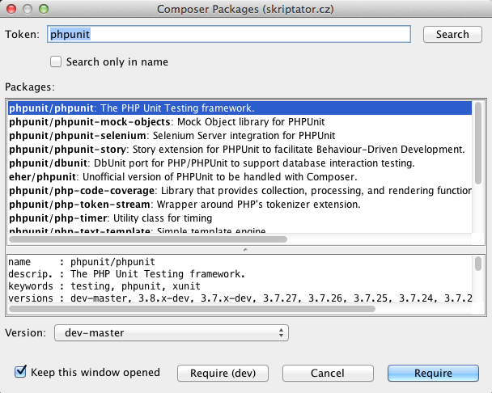
New in PHP
NEW 7.4
Out of the Box PHP Support
HTML5 Development for PHP Projects
Editor enhancements
Enhanced frameworks:
Twig, Apache Conf, NEON, INI
New frameworks:
Nette, Zend 2, atoum
New static code analysis:
Code Sniffer, Mess Detector

Slide 39
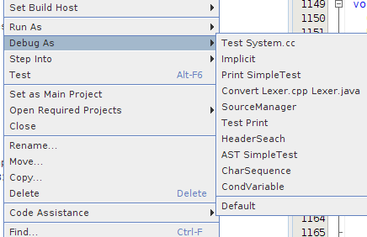
Support for C/C++
Feature Overview
Optimized for large applications
Advanced language-aware code editor, e.g., syntax coloring, code completion, navigation, formatting, and hints
Rich reverse engineering capabilities, e.g., Find Usages, Call Graph, Class Hierarchy, Macro View, and Include Hierarchy
Visual Debugging
Refactoring
Unit tests support for CUnit/CppUnit
Remote Development

Slide 40
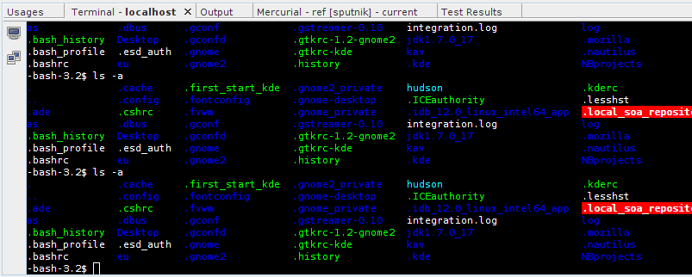
New in C/C++
NEW
Out of the Box C/C++ Support
Create projects from binary file
Templates & specialized navigation
Browse remote file system
Integrated terminal
C++11 support
Compile single file action
C++ documentation view
Memory usage improvements 2x
QT5 support
Run/debug launchers

Slide 41
Miscellaneous IDE Tools
Notes:
In this presentation, you’ll be focusing on new features in NetBeans IDE, while also providing a context for those of your audience who are not familiar with NetBeans IDE.

Slide 42
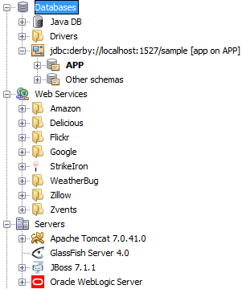
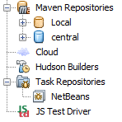
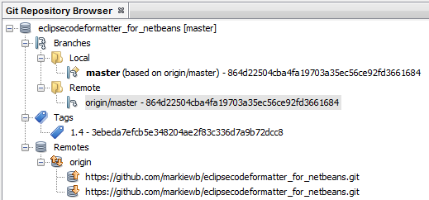
Miscellaneous IDE Tools
Feature Overview
Project Views
Services Management
Build Tools
Ant, Maven, Gradle plugin
Versioning Tools
Git, Subversion, Mercurial
Navigators
Terminal Emulator
Plugin Manager
Action Items (Problem View)
Bookmark Management

Slide 43
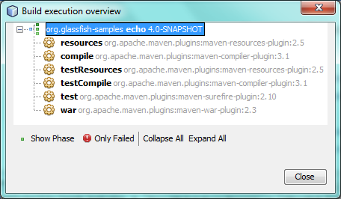
Maven
NEW 7.3 7.4
Out of the Box Maven
Effective POM editor
Reworked compile-on-save
Build execution overview dialog
Memory usage enhancements
Performance enhancements

Slide 44
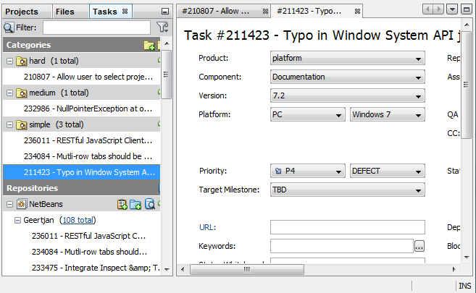
Task Management
NEW 7.4
Out of the Box Task Management
New Tasks Window
Manage issue trackers Bugzilla and JIRA
Create and categorize queries, receive notifications on updates
Create and categorize tasks
Filter and search your tasks and queries

Slide 45
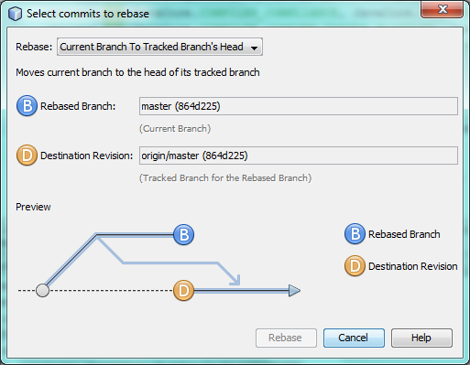
Versioning Tool Enhancements
NEW 7.4
Out of the Box Versioning Control Support
Visual tools for
git --pull rebase
git --commit amend
Mercurial, Git, Subversion diffing between branches
Support for SSH agent
Subversion 1.8

Slide 46
Summary
Notes:
In this presentation, you’ll be focusing on new features in NetBeans IDE, while also providing a context for those of your audience who are not familiar with NetBeans IDE.

Slide 47
Major Features per Release
The Smarter and Faster Way to Code
NetBeans IDE 7.0 – support for JDK 7
NetBeans IDE 7.1 – support for JavaFX 2
NetBeans IDE 7.2 – Static Java code analysis, e.g., FindBugs integration, together with smarter project scanning and performance enhancements
NetBeans IDE 7.3 – HTML5 tools, such as HTML5 editor, JavaScript Editor, JavaScript debugger, CSS3 visual editor, and integration with Chrome browser, Java EE 7 support
NetBeans IDE 7.4 – HTML5 tools for Java EE and PHP, Cordova mobile device development, preview support for JDK 8

Slide 48





Performance Enhancements

Slide 49
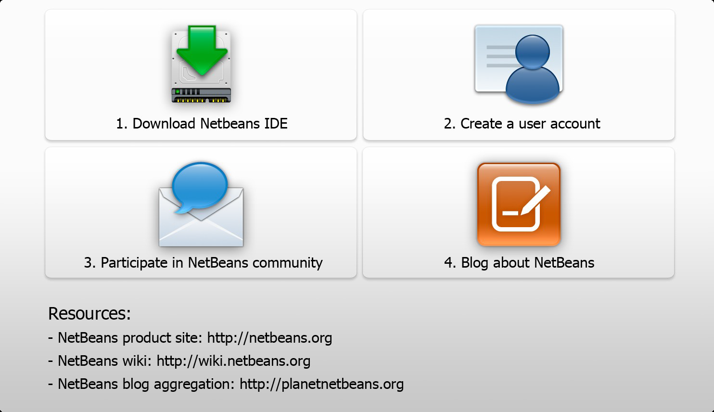
Next Steps

Slide 50


Oracle Technology Network
For Java Developers
Resources for You
Technical Content on oracle.com/technetwork/java
Java Magazine (100K subscribers)
Java Developer Newsletter (700K subscribers)
Free Developer Days events.oracle.com
Project space on java.net (7K+ projects)
@java, Facebook/IloveJava
Path to Recognition
Content by You!
Send links to blogs, videos, and proposals for articles to otnfeedback_us@oracle.com

